Slide 1

Sprocket Central Pty Ltd Data Analytics Approach

Slide 2
AGENDA
The approach will be implemented in three stages :
Data Exploration
Model Development
Interpretation

Slide 3
AGENDA
Approach for New Customer Data Analysis :
Age Distribution
Bike Purchase
Job Industry
Number of Cars owned

Slide 4
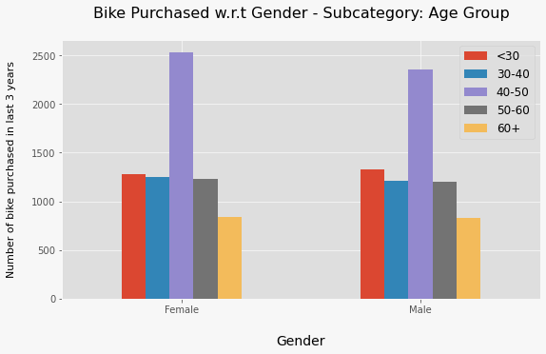
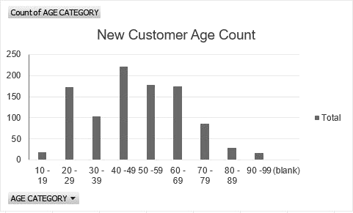
Data Exploration : Age Distribution And Bike Purchases
New customers range more from the age group of 40 – 49, followed by 50 – 59 and 60 – 69
Fewer customers are aged between 10 -19 and 90 – 99
Data shows that the age group with the highest count in bike purchases in the past 3 years is 40 – 50, with a slightly greater female ratio
The target audience for our marketing and advertising strategy should be more focused on females than males

Slide 5
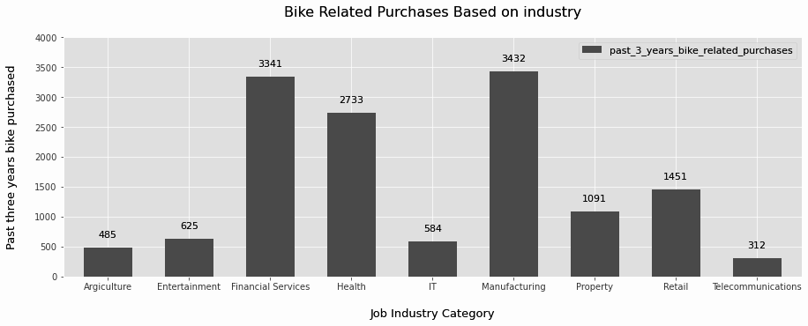
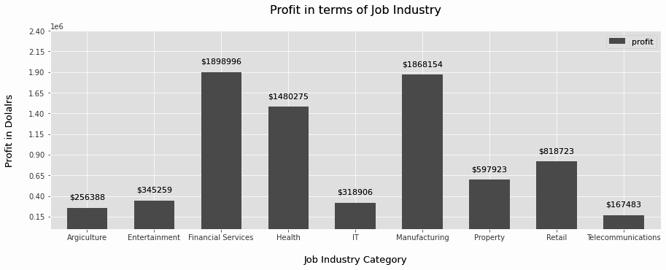
Data Exploration : Job industry
Financial services, Manufacturing, and Health are the top three profit- generating industries, followed by Retail and Property
The highest profits are also from Financial Services, Manufacturing and Health as seen in the second Chart

Slide 6
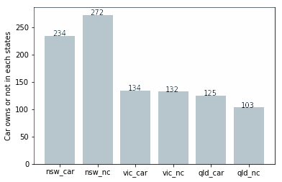
Data Exploration : car owners
Out of 3 states, New South Wales, could be a potential market for the company
New South Wales has the highest potential because the number of people who own vehicles is nearly equal to the number of people who do not own cars. Therefore it indicates there is room for valued customers
VIC and QLD has more customers that own cars than who do not. But there is a potential to make those who already own cars buy bikes.

Slide 7
Model development
Customer Classification – Targeting High Value Customers
The following are high value clients to target:
Aged between 40 -50
Females
Working in Financial Services, Manufacturing and Health Industry
Currently living in New South Wales and Victoria

Slide 8
Intepretation
High – Value Customer Summary Table
Customer ID | Bike Related Purchases for the last 3 years | Age | Job Industry | Wealth Segment | Owns Cars | State
1842 | 445 | 44 | Financial Services | Mass Customer | No | New South Wales
2001 | 168 | 44 | Manufacturing | Mass Customer | Yes | New South Wales
650 | 486 | 44 | Health | Mass Customer | No | New South Wales
3297 | 234 | 46 | Manufacturing | Mass Customer | No | Victoria
50 | 266 | 41 | Manufacturing | Mass Customer | Yes | New South Wales

Slide 9
THE END
THANK YOU!

